Slide 1

British Sign Language Detection Using Machine Learning
Reflective Report on Model Development

Slide 2
Introduction
Overview of the project’s objective: Developing a machine learning model to recognize British Sign Language (BSL) letters.
The Dataset is self made and the model is build using CNN and ANN layers
Recognizes British sign language’s all alphabets except J and H (as they are dynamic)
Makes the recognitions on a live video feed from the webcam
The model is lightweight and gives practically usable FPS

Slide 3
Dataset Collection Approach
Image Collection Method: Capturing live images via OpenCV.
Resolution: 48x48 grayscale images.
Dataset Composition:
  250 images per label (A-Z, excluding H & J due to dynamic movement).
  A blank category included.
Preprocessing: Resizing, grayscale conversion, and dataset split (80% train, 20% validation).

Slide 4
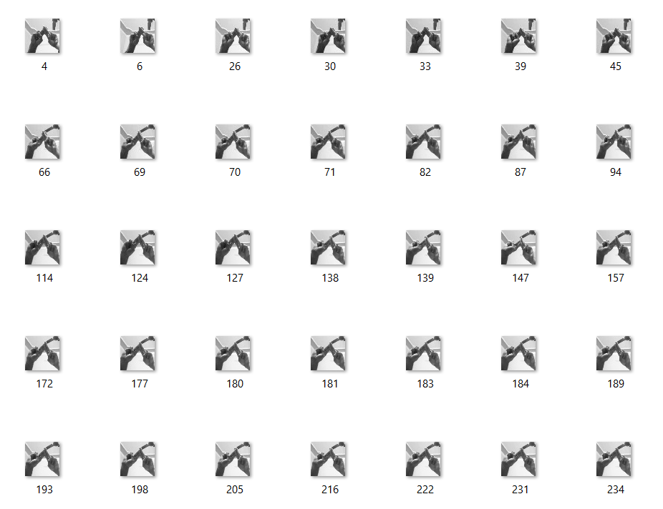
Preprocessing
A dataset similar to the one shown is used
The images are extracted from a rectangular frame on the screen
The images are turned into 48*48 grayscale images for the model to be lightweight and mobile
Data Augmentation techniques were used , and the images are scaled from 0 to 1

Slide 5
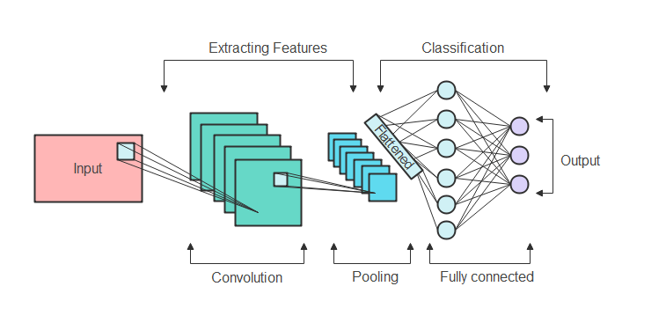
Model Architecture
Conv2D (128 filters, 3x3) → MaxPooling → Dropout (40%)
Conv2D (256 filters) → MaxPooling → Dropout (40%)
Conv2D (512 filters) → MaxPooling → Dropout (40%)
Conv2D (512 filters) → MaxPooling → Dropout (40%)
Dense layers (512, 64, 256 neurons with dropout layers in between)
Output Layer: 25 neurons (Softmax activation for multi-class classification)

Slide 6
Model Training Process
Optimization: Adam optimizer with categorical cross-entropy loss.
Epochs: 100 for stable convergence.
Batch Normalization: Applied to enhance generalization.
Results: Accuracy improvements over training epochs.

Slide 7
Deployment and Real Time Testing
Model Storage: Saved in JSON and H5 formats.
Real-Time Inference:
  Webcam captures hand gestures.
  Model predicts corresponding BSL letters.
  Displays classification results with confidence scores.

Slide 8
Conclusion & Future Scope
Achievements:
  Successfully recognized static BSL letters.
  Achieved efficient real-time performance.
Future Enhancements:
  Improve dynamic sign detection.
  Expand dataset for better accuracy.
  Develop a full-fledged BSL translation system.
  -Thank you

